Slide 1
Convolutional Neural Networks

Slide 2
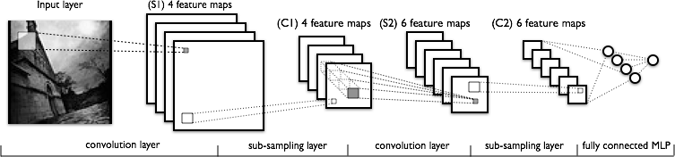
Convolutional Neural Networks
Feedforward networks
Well-suited to image recognition

Slide 3
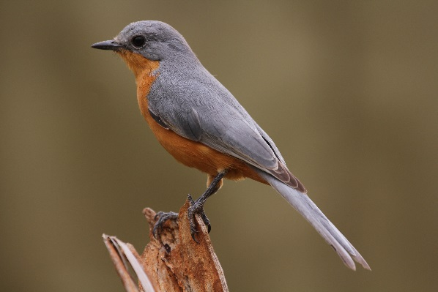
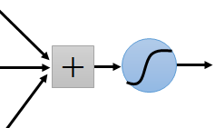
Why CNN for Image
Some patterns are much smaller than the whole image
A neuron does not have to see the whole image to discover the pattern.
Connecting to small region with less parameters
“beak” detector

Slide 4
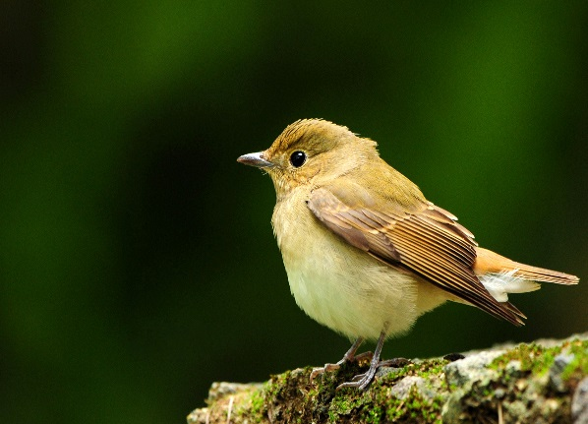
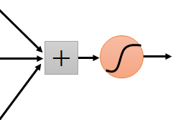
Why CNN for Image
The same patterns appear in different regions.
“upper-left beak” detector
Do almost the same thing
They can use the same set of parameters.
“middle beak” detector

Slide 5
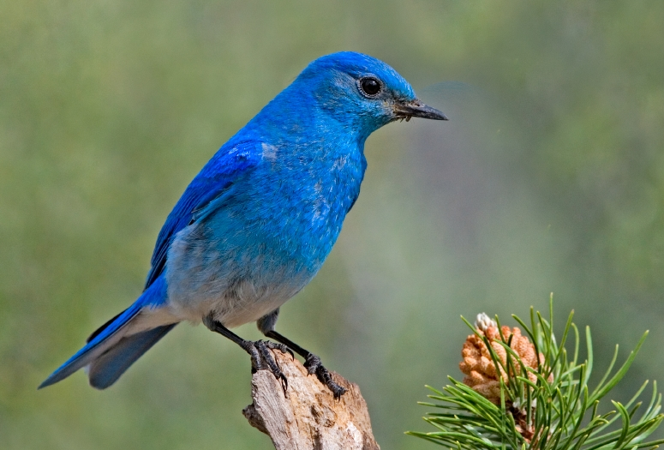

Why CNN for Image
Subsampling the pixels will not change the object
bird
bird
subsampling
We can subsample the pixels to make image smaller
Less parameters for the network to process the image

Slide 6
Why CNN for Image
If using fully connected MLP to recognize large images, e.g. 200x200 pixels, there are too many weights (edges) to train.
  Time consuming
  Over fitting
CNNs typically have sparse connectivity, i.e. one unit connects to only some units in previous layer. → reduce parametres
The weights of the partially connectives are repeatedly used in every unit. → parameter sharing
For the same partial inputs in different locations, with parameter sharing, the same representations will be produced. → equivariance to translation

Slide 7
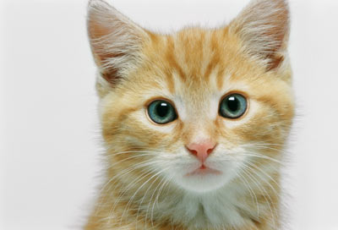
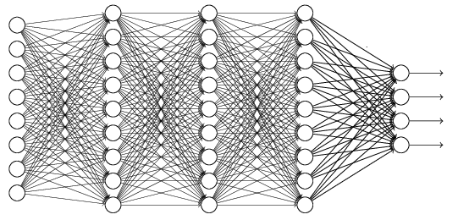
The whole CNN
cat dog ……
Convolution
Max Pooling
Can repeat many times
Fully Connected Feedforward network
Convolution
Max Pooling
Flatten

Slide 8
The whole CNN
Property 1
Some patterns are much smaller than the whole image
Convolution
Property 2
Max Pooling
The same patterns appear in different regions.
Can repeat many times
Property 3
Convolution
Subsampling the pixels will not change the object
Max Pooling
Flatten

Slide 9
The whole CNN
cat dog ……
Convolution
Max Pooling
Can repeat many times
Fully Connected Feedforward network
Convolution
Max Pooling
Flatten

Slide 10
Convolutional layers
  Apply a number of filters across to the input image to form feature maps (FM).
  If the previous layer is also convolutional, the filters are applied across all of it’s FMs with different weights
Subsampling layers
  Reduce the size of the input
    E.g., 32x32 image -> 16x16 image

Slide 11
The last subsampling (or convolutional) layer is usually connected to one or more fully connected layers, the last of which represents the target data.
Training is performed using modified backpropagation that takes the subsampling layers into account and updates the convolutional filter weights based on all values to which that filter is applied.

Slide 12
CNN – Convolution
Those are the network parameters to be learned.
1 | -1 | -1
-1 | 1 | -1
-1 | -1 | 1
1 | 0 | 0 | 0 | 0 | 1
0 | 1 | 0 | 0 | 1 | 0
0 | 0 | 1 | 1 | 0 | 0
1 | 0 | 0 | 0 | 1 | 0
0 | 1 | 0 | 0 | 1 | 0
0 | 0 | 1 | 0 | 1 | 0
Filter 1
Matrix
-1 | 1 | -1
-1 | 1 | -1
-1 | 1 | -1
Filter 2
Matrix
……
6 x 6 image
Each filter detects a small pattern (3 x 3).
Property 1

Slide 13
CNN – Convolution
1 | -1 | -1
-1 | 1 | -1
-1 | -1 | 1
Filter 1
stride=1
1 | 0 | 0 | 0 | 0 | 1
0 | 1 | 0 | 0 | 1 | 0
0 | 0 | 1 | 1 | 0 | 0
1 | 0 | 0 | 0 | 1 | 0
0 | 1 | 0 | 0 | 1 | 0
0 | 0 | 1 | 0 | 1 | 0
3
-1
6 x 6 image

Slide 14
CNN – Convolution
1 | -1 | -1
-1 | 1 | -1
-1 | -1 | 1
Filter 1
If stride=2
1 | 0 | 0 | 0 | 0 | 1
0 | 1 | 0 | 0 | 1 | 0
0 | 0 | 1 | 1 | 0 | 0
1 | 0 | 0 | 0 | 1 | 0
0 | 1 | 0 | 0 | 1 | 0
0 | 0 | 1 | 0 | 1 | 0
3
-3
We set stride=1 below
6 x 6 image

Slide 15
CNN – Convolution
1 | -1 | -1
-1 | 1 | -1
-1 | -1 | 1
Filter 1
stride=1
1 | 0 | 0 | 0 | 0 | 1
0 | 1 | 0 | 0 | 1 | 0
0 | 0 | 1 | 1 | 0 | 0
1 | 0 | 0 | 0 | 1 | 0
0 | 1 | 0 | 0 | 1 | 0
0 | 0 | 1 | 0 | 1 | 0
3
-1
-3
-1
-3
1
0
-3
-3
-3
0
1
3
-2
-2
-1
6 x 6 image
Property 2

Slide 16
CNN – Convolution
-1 | 1 | -1
-1 | 1 | -1
-1 | 1 | -1
Filter 2
stride=1
Do the same process for every filter
1 | 0 | 0 | 0 | 0 | 1
0 | 1 | 0 | 0 | 1 | 0
0 | 0 | 1 | 1 | 0 | 0
1 | 0 | 0 | 0 | 1 | 0
0 | 1 | 0 | 0 | 1 | 0
0 | 0 | 1 | 0 | 1 | 0
3
-1
-3
-1
-1
-1
-1
-1
-3
1
0
-3
-1
-1
-2
1
Feature
Map
-3
-3
0
1
-1
-1
-2
1
3
-2
-2
-1
6 x 6 image
-1
0
-4
3
4 x 4 image

Slide 17
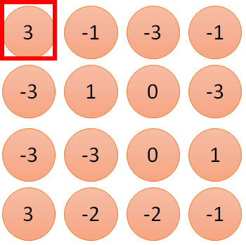
1 | -1 | -1
-1 | 1 | -1
-1 | -1 | 1
1:
1
Filter 1
2:
0
3:
0
3
4:
0
1 | 0 | 0 | 0 | 0 | 1
0 | 1 | 0 | 0 | 1 | 0
0 | 0 | 1 | 1 | 0 | 0
1 | 0 | 0 | 0 | 1 | 0
0 | 1 | 0 | 0 | 1 | 0
0 | 0 | 1 | 0 | 1 | 0
…
7:
0
8:
1
9:
0
10:
0
…
13:
0
6 x 6 image
14:
0
Less parameters!
15:
Only connect to 9 input, not fully connected
1
16:
1
…

Slide 18
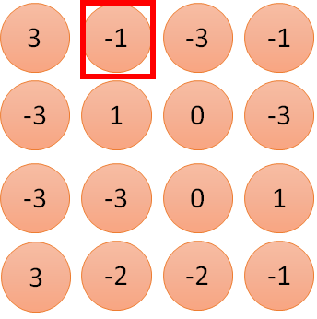
1 | -1 | -1
-1 | 1 | -1
-1 | -1 | 1
1:
1
Filter 1
2:
0
3:
0
3
4:
0
1 | 0 | 0 | 0 | 0 | 1
0 | 1 | 0 | 0 | 1 | 0
0 | 0 | 1 | 1 | 0 | 0
1 | 0 | 0 | 0 | 1 | 0
0 | 1 | 0 | 0 | 1 | 0
0 | 0 | 1 | 0 | 1 | 0
…
7:
0
8:
1
-1
9:
0
10:
0
…
13:
0
6 x 6 image
14:
0
Less parameters!
15:
1
16:
1
Shared weights
Even less parameters!
…

Slide 19
CNN – Convolution
1 | -1 | -1
-1 | 1 | -1
-1 | -1 | 1
Filter 1
Padding
0 | 0 | 0 | 0 | 0 | 0 | 0 | 0
0 | 1 | 0 | 0 | 0 | 0 | 1 | 0
0 | 0 | 1 | 0 | 0 | 1 | 0 | 0
0 | 0 | 0 | 1 | 1 | 0 | 0 | 0
0 | 1 | 0 | 0 | 0 | 1 | 0 | 0
0 | 0 | 1 | 0 | 0 | 1 | 0 | 0
0 | 0 | 0 | 1 | 0 | 1 | 0 | 0
0 | 0 | 0 | 0 | 0 | 0 | 0 | 0
2
After convolution, the size of feature map is the same as original image
Padding with 0s

Slide 20
CNN – Max Pooling
1 | -1 | -1
-1 | 1 | -1
-1 | -1 | 1
-1 | 1 | -1
-1 | 1 | -1
-1 | 1 | -1
Filter 1
Filter 2
3
-1
-3
-1
-1
-1
-1
-1
-3
1
0
-3
-1
-1
-2
1
-3
-3
0
1
-1
-1
-2
1
3
-2
-2
-1
-1
0
-4
3

Slide 21
CNN – Max Pooling
New image
but smaller
1 | 0 | 0 | 0 | 0 | 1
0 | 1 | 0 | 0 | 1 | 0
0 | 0 | 1 | 1 | 0 | 0
1 | 0 | 0 | 0 | 1 | 0
0 | 1 | 0 | 0 | 1 | 0
0 | 0 | 1 | 0 | 1 | 0
Conv
3
0
-1
1
Max
Pooling
3
1
0
3
2 x 2 image
6 x 6 image
Each filter
is a channel

Slide 22
The whole CNN
3
0
-1
1
Convolution
3
1
0
3
Max Pooling
Can repeat many times
A new image
Convolution
Smaller than the original image
The number of the channel is the number of filters
Max Pooling

Slide 23
The whole CNN
cat dog ……
Convolution
Max Pooling
A new image
Fully Connected Feedforward network
Convolution
Max Pooling
A new image
Flatten

Slide 24
Flatten
3
0
1
3
0
-1
1
3
3
1
-1
0
3
Flatten
1
Fully Connected Feedforward network
0
3

Slide 25
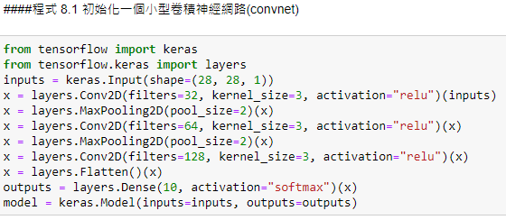
CNN for Mnist Data Set
Conv2D(): 2D convolution layer
filters: the dimensionality of the output space (i.e. the number of output filters in the convolution)
kernel_size: the height and width of the 2D convolution window
strides: specifying the strides of the convolution along the height and width.
padding: "valid" means "no padding". "same" results in padding the input such that the output has the same length as the original input.
activation: Activation function to use. If you don't specify anything, no activation is applied (ie. "linear" activation: a(x) = x)
Flatten(): Flattens the input. (here 3*3*128 = 1152)
MaxPooling2D(): Max pooling operation for spatial data
pool_size: factors by which to downscale (vertical, horizontal)
strides: Strides values. If "None", it will default to pool_size.

Slide 26
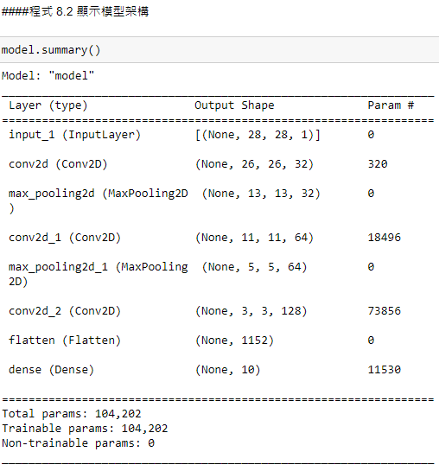

Slide 27
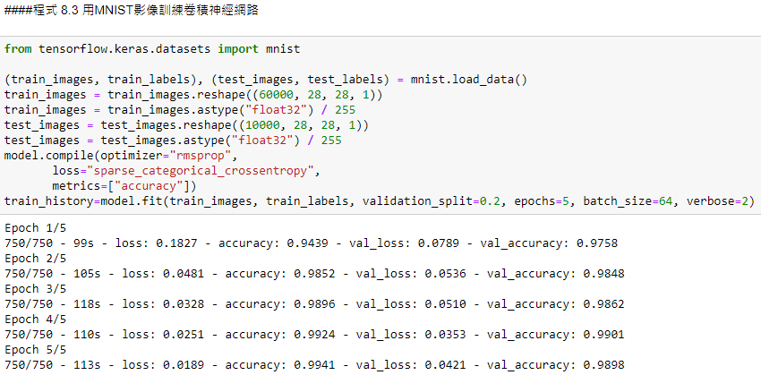
Reshape image featrues to 6000*28*28*1 matrix
Normalize image featrues

Slide 28
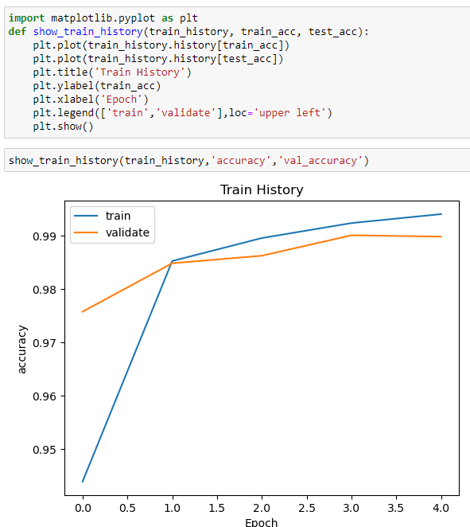
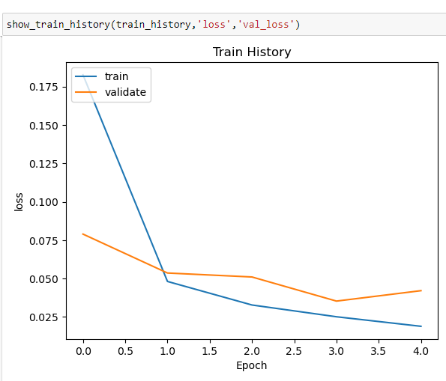

Slide 29
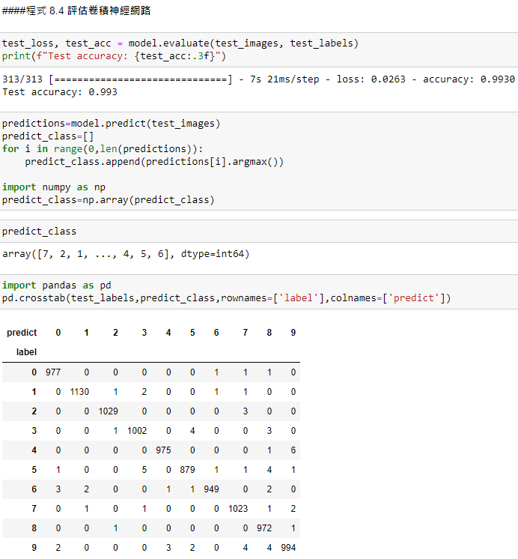

Slide 30
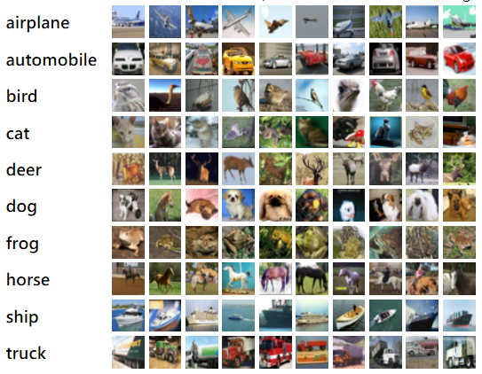
CNN for CIFAR-10 Dataset
The CIFAR-10 dataset consists of 60000 32x32 colour images in 10 classes, with 6000 images per class. There are 50000 training images and 10000 test images.
http://www.cs.toronto.edu/~kriz/cifar.html

Slide 31
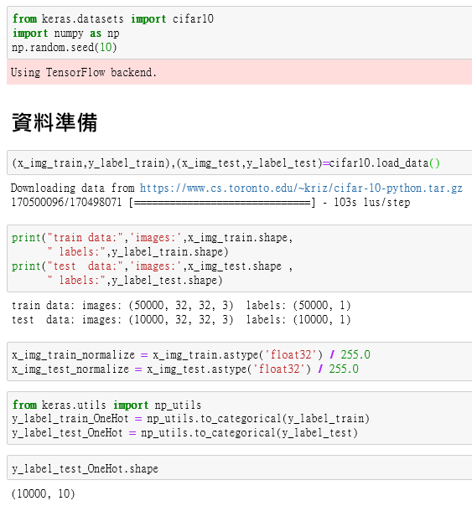
5000 images, size: 32x32, 3 colors(RGB)
…

Slide 32
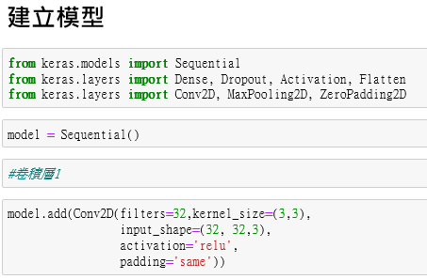
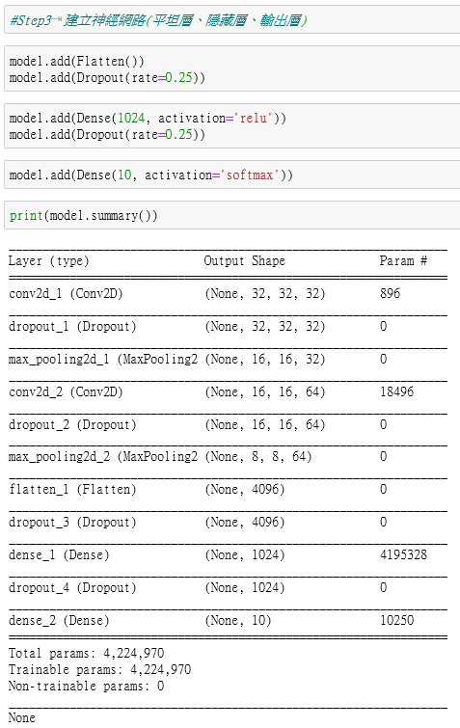
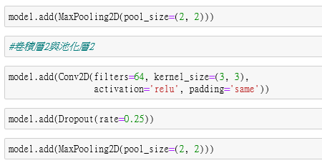

Slide 33
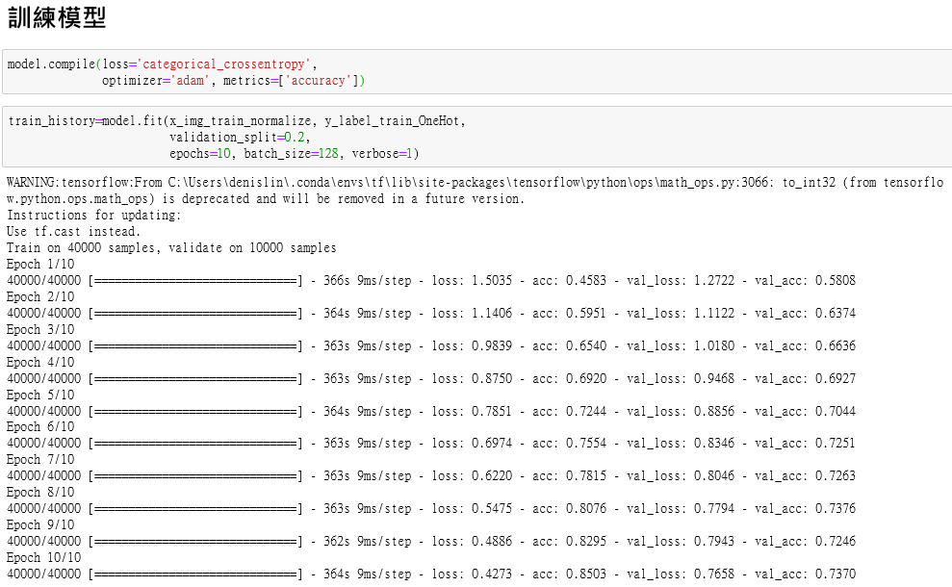

Slide 34
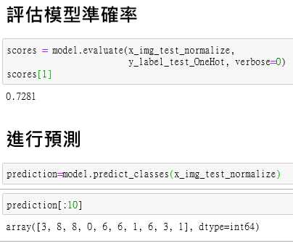
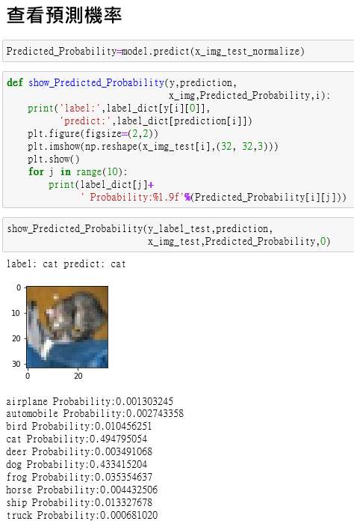

Slide 35
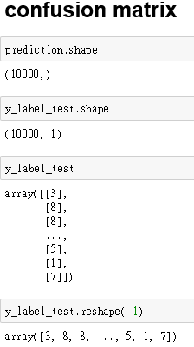
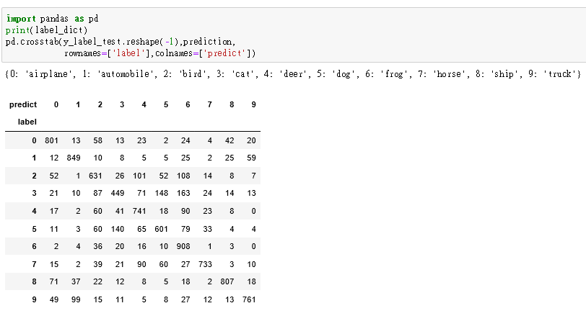

Slide 36
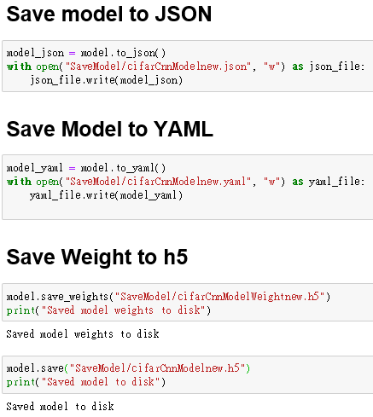

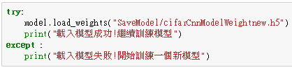
save the architecture of a model, and not its weights or its training configuration
save the architecture of a model, and not its weights or its training configuration
save only the weights of a model
Saving whole model (architecture + weights + training configuration + optimizer state) into a single HDF5 file
build a fresh model from a file
Load whole model
load the weights into a model with the same architecture

Slide 37
CNN for CT Medical Images
A tiny subset of images from the cancer imaging archive
Middle slice of all CT images
Associated with using contrast and patient age
Predict if using contrast

Slide 38
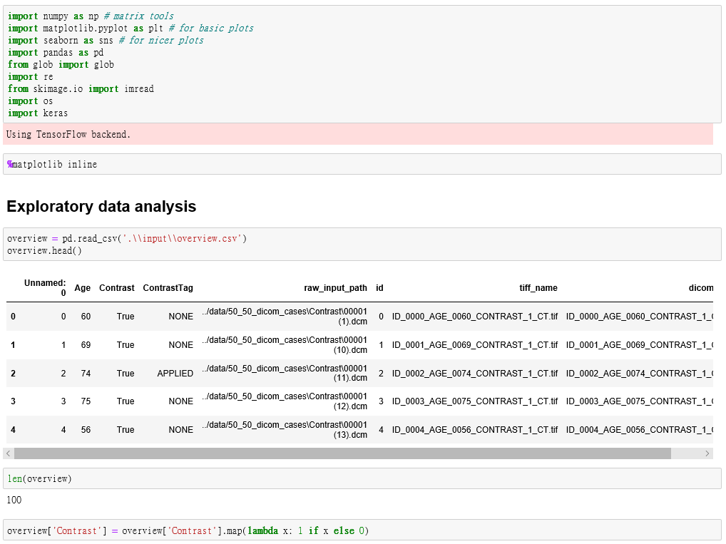
Set the backend of matplotlib to the 'inline' backend.
The output of plotting commands is displayed inline within frontends like the Jupyter notebook, directly below the code cell that produced it. The resulting plots will then also be stored in the notebook document.
Transform string values TRUE/FALSE to integer 1 / 0

Slide 39
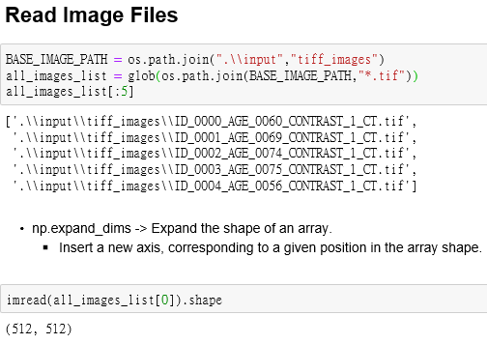
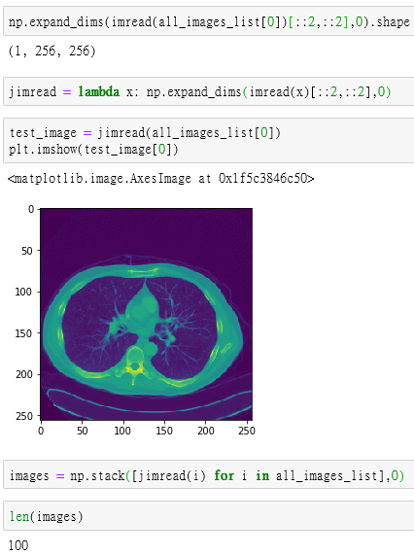
Return a list of path names that match a pattern of path
exapnd_dims: Insert a new axis, corresponding to a given position in the array shape.
[: :2][: :2]: select array elements with stepwise 2. Downsize to half.
Read all images into an array

Slide 40
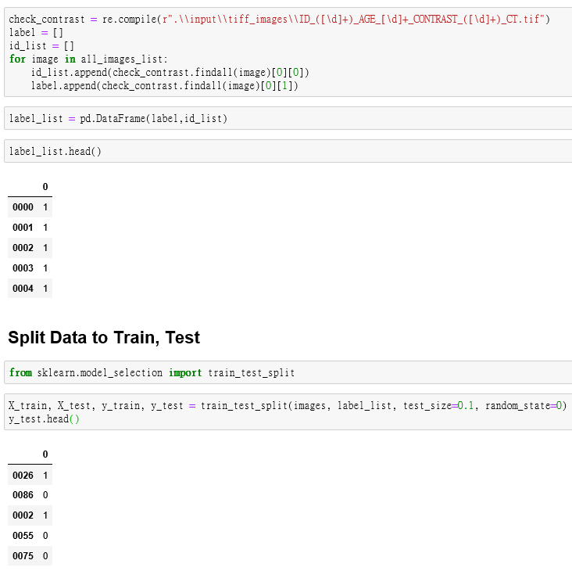
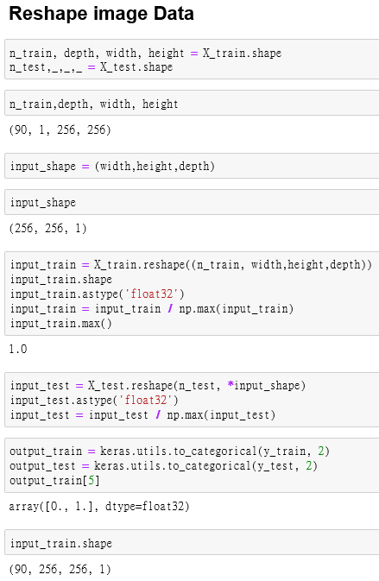

Slide 41
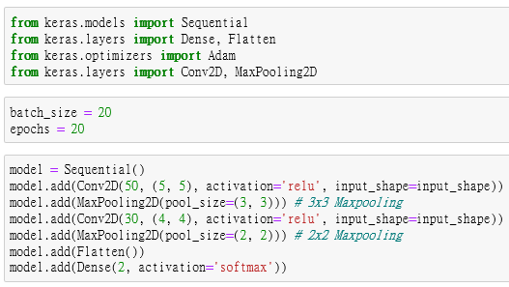
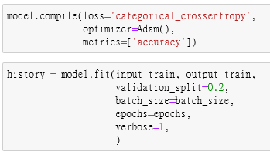

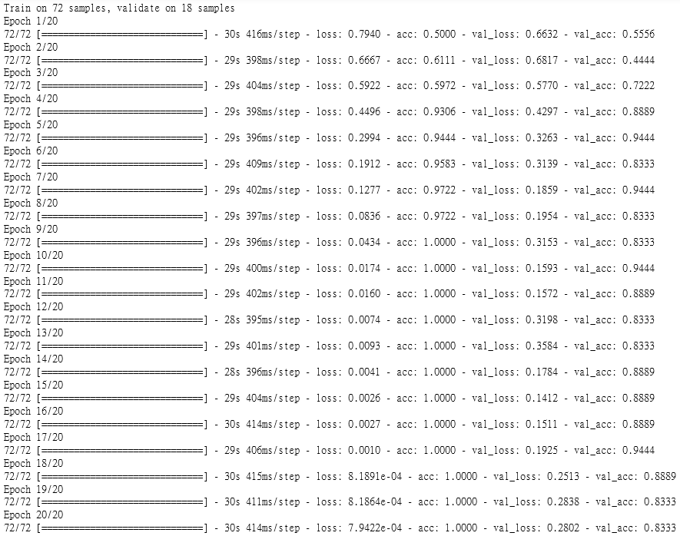
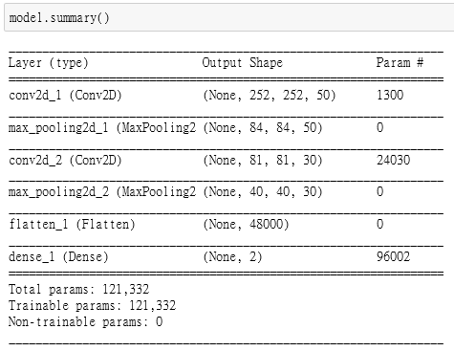

Slide 42
Powerful CNN Architectures
https://medium.com/datadriveninvestor/five-powerful-cnn-architectures-b939c9ddd57b
https://ithelp.ithome.com.tw/articles/10192162
DenseNet
  https://iter01.com/568757.html
Image Segmentation
  https://medium.com/ching-i/%E5%BD%B1%E5%83%8F%E5%88%86%E5%89%B2-image-segmentation-%E8%AA%9E%E7%BE%A9%E5%88%86%E5%89%B2-semantic-segmentation-1-53a1dde9ed92

